Slide 1

Networking and Data Security COMP 8677 Chapter 8: Network Security Challenges- II
Mahdi D. Firoozjaei
School of Computer Science, University of Windsor

Slide 2

Reference
Internet Security: A Hands-on Approach
2nd Edition (ISBN: 978-1733003919)
Wenliang Du Pearson, 2020
https://www.handsonsecurity.net/index.html

Slide 3

Network Security Challenges
Socket Programming in Python
TCP Attacks
TCP Reset Attack on Telnet
TCP Session Hijacking
Reverse Shell
https://www.cgi.com/uk/en-gb/space/space-cyber-security

Slide 4

Socket Programming in Python

Slide 5
Socket Programming in Python [1, 2, 3]
Sockets programming connects two sockets in different machines and enables them to send and receive data, bi-directionally, at any given moment
Internet-connected applications need real-time operation and implement sockets in their networking code.
Web pages that show live notifications (Facebook, Twitch, eBay)
Multiplayer online games (League of Legends, WoW, Counter Strike)
Chat apps (WhatsApp, WeChat, Slack)
Real-time data dashboards (Robinhood, Coinbase)
IoT devices (Nest, August Locks)
[1] Socket Programming in Python (Guide) https://realpython.com/python-sockets/#socket-api-overview
[2 Socket Programming HOWTO https://docs.python.org/3/howto/sockets.html
[3] Adam Bavosa, Socket Programming in Python: Client, Server, and Peer, 2020, https://www.pubnub.com/blog/socket-programming-in-python-client-server-p2p/

Slide 6
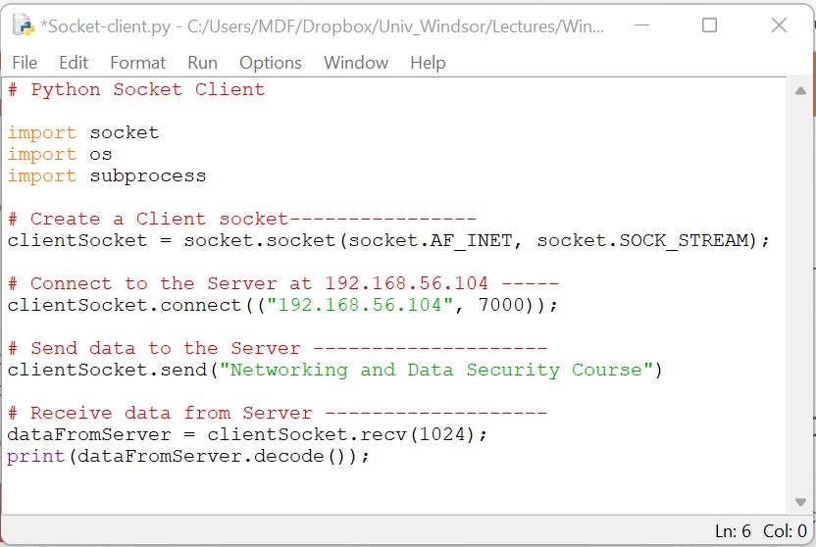
Socket Programming in Python [1, 2, 3]
Client Socket
Create a Socket Object in client side
Connect to the server with IP: 192.168.56.104 and at port: 7000
[1] Socket Programming in Python (Guide) https://realpython.com/python-sockets/#socket-api-overview
[2 Socket Programming HOWTO https://docs.python.org/3/howto/sockets.html
[3] Adam Bavosa, Socket Programming in Python: Client, Server, and Peer, 2020, https://www.pubnub.com/blog/socket-programming-in-python-client-server-p2p/

Slide 7
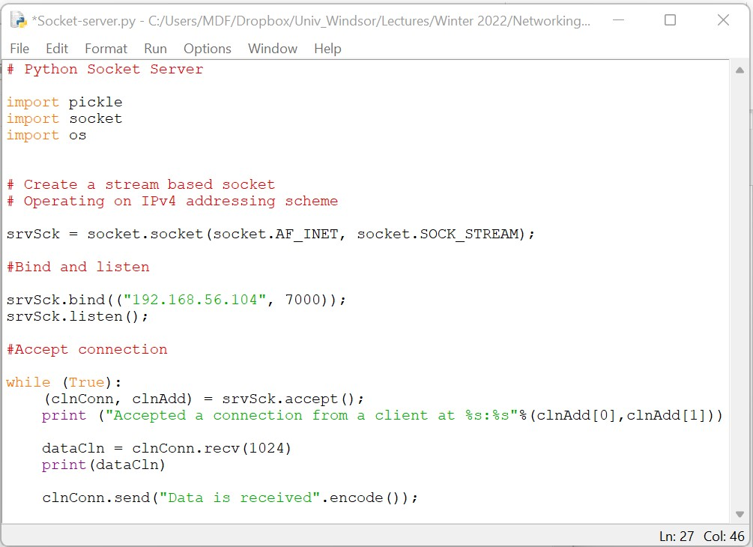
Socket Programming in Python [1, 2, 3]
Server Socket
Create a Socket Object in client side
Created socket object is bind to localhost’s port 7000 as a socket server
And listens for data sent by the client
Server’s IP: 192.168.56.104
[1] Socket Programming in Python (Guide) https://realpython.com/python-sockets/#socket-api-overview
[2 Socket Programming HOWTO https://docs.python.org/3/howto/sockets.html
[3] Adam Bavosa, Socket Programming in Python: Client, Server, and Peer, 2020, https://www.pubnub.com/blog/socket-programming-in-python-client-server-p2p/

Slide 8


Network Security Challenges
TCP Attacks
Attacker
Target
TCP Reset
TCP Session Hijacking

Slide 9
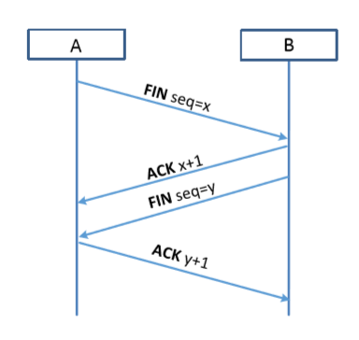
TCP Connection Finish
To disconnect a TCP connection:
A sends out a “FIN” packet to B
B replies with an “ACK” packet. This closes the A-to-B communication.
B sends a “FIN” packet to A and A replies with “ACK”

Slide 10
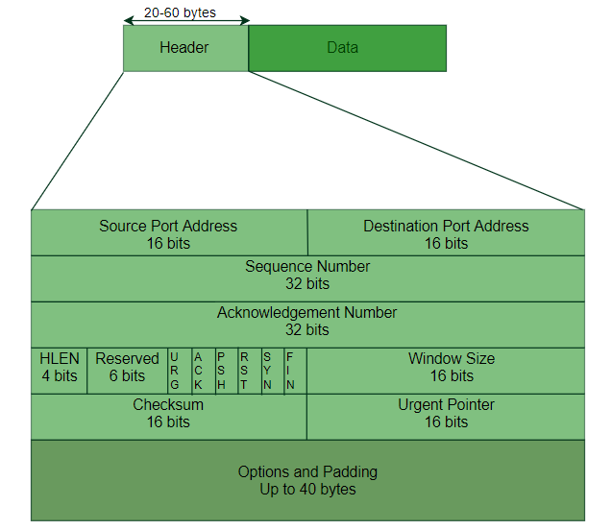
TCP Connection Reset
TCP segment
TCP Reset flag:
One of the parties sends RST packet to immediately break the connection

Slide 11
TCP Reset Attack
TCP Connection
RST
IP: 10.9.0.5
TCP port: 8070
TCP Reset
IP: 10.9.0.120
TCP port: 1500
Attacker
To break up a TCP connection between A and B:
The attacker should spoof a TCP RST message
Following fields should be set correctly:
Source IP address, Source Port,
Destination IP address, Destination Port
Sequence number (within the receiver’s window)

Slide 12
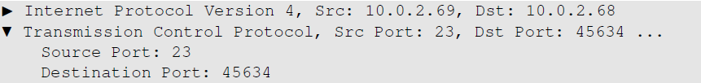
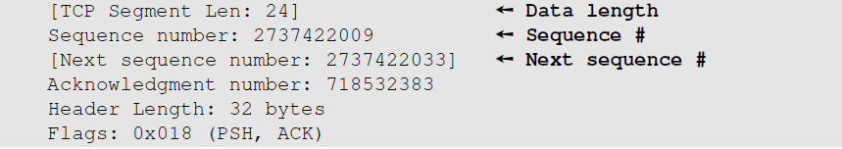
TCP Reset Attack
Use a sniffing tool (e.g., Wireshark) on attacker machine, to sniff the traffic
Retrieve the destination port, source port number, and sequence number

Slide 13
TCP Session Hijacking Attack
TCP Connection
IP: 10.9.0.5
TCP port: 8070
IP: 10.9.0.120
TCP port: 1500
Attacker
To inject data in an established TCP connection:
The attacker should spoof a TCP Segments
Following fields should be set correctly:
Source IP address, Source Port,
Destination IP address, Destination Port
Sequence number (within the receiver’s window)
Same header fields:
Source IP
Destination IP
Source Port
Destination Port

Slide 14
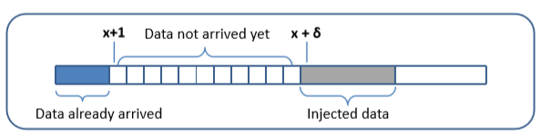
TCP Session Hijacking Attack: Sequence Number
If the receiver has already received some data up to the sequence number x, the next sequence number is x+1
If the spoofed packet uses sequence number as x+𝛿, it becomes out of order
The data in this packet will be stored in the receiver’s buffer at position x+𝛿, leaving 𝛿 spaces (having no effect). If 𝛿 is large, it may fall out of the boundary.

Slide 15
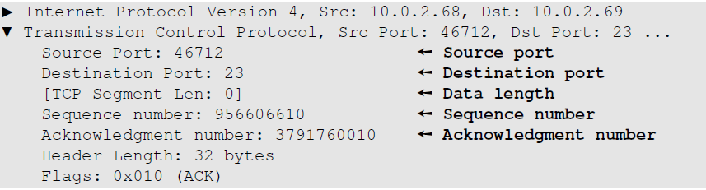
Hijacking a Telnet Connection
User establishes a telnet connection with the server
Use Wireshark on attacker machine to sniff the traffic
Retrieve the destination port (23), source port number (46712) and sequence number

Slide 16
References:
Wenliang Du, Internet Security: A Hands-on Approach, 2nd Edition, ISBN: 978-1733003919, 2020, https://www.handsonsecurity.net/index.html
An Introduction to Computer Networks, Release 2.0.6, Peter L Dordal, 2020, http://intronetworks.cs.luc.edu/current/ComputerNetworks.pdf
Okta, ARP Poisoning: Definition, Techniques, Defense & Prevention, 2021, https://www.okta.com/identity-101/arp-poisoning/
Janira Pérez Sánchez, Cryptography: history and curiosities, the importance today, 2021, https://atalayar.com/en/content/cryptography-history-and-curiosities-importance-today
ICMP redirect attacks with Scapy, 2019, https://ivanitlearning.wordpress.com/2019/05/20/icmp-redirect-attacks-with-scapy/
End
School of Computer Science, University of Windsor

